Slide 1
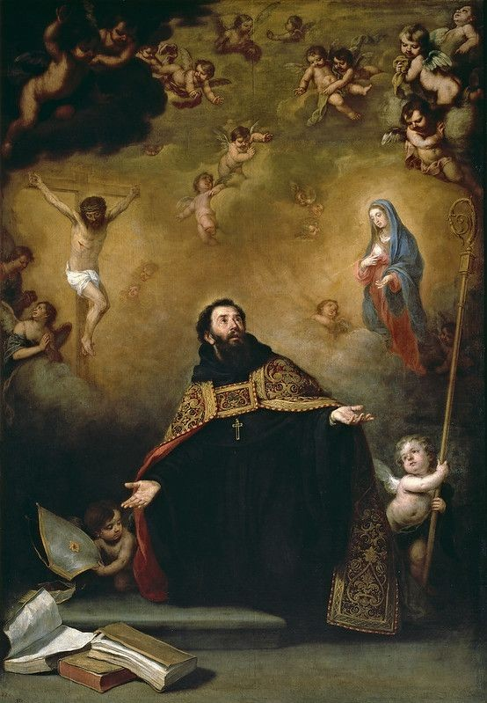
Autobiography: A Study
With respect to gusdorf’s “Conditions and Limits of Autobiography” and de Man’s “Autobiography as De-Facement”

Slide 2
Conditions and Limits of AutOBIOGRAPHY -GEORGES GUSDORF

Slide 3
Autobiography; meaning [According to Georges Gusdorf]
A solidly established genre
Exists unquestionably in a fine state
Not to be found outside our cultural area
Mirror that reflects the true image
A moment of life that it recounts
A finished image of an individual life

Slide 4
Autobiography vs biography
Author knows his intension
Memories recollected and relived
Author is the model himself
An account of the author’s life
A mirror that reflects his own image
No intention known just a research
Just a work / research on other’s life
Works on a person who becomes a model
A account of other’s life
A painting that just allows description

Slide 5
conditions and limits ideal in writing autobiography
Reasons for writing autobiography
Quest for identity
Need of self expression
Need to explain and justify the self
Self relevance to cultural criticism
Conditions of autobiography
It is a mirror image of life
Cannot be pure and simple record of existance
Not possible under cultural landscape
Not a simple recapitulation of past
Limitations
Failure of memory
Unchanged outcome
Limited to public sector of existance
Assumes the task of reconstructing unity of life across time
Logical coherence and rationalisation

Slide 6
Autobiography as a social and literary documentation
“Consciousness of self is the birthplace of truth”- Hegel
Appeasement of the anguished uneasiness of an aging man
Every autobiography is a work of art, and at the same time a work of enlightenment

Slide 7
Autobiography, journal, and memoir
Autobiography cannot be a pure and simple record of existence.
Memoirs, a revenge on history.

Slide 8
Autobiography as DE–Facement -- Paul de man

Slide 9
Autobiography within systems
Paul de Man
The recurrent approach
A literary genre
Generic definition

Slide 10
Autobiography; an ambiguity
Distinction between autobiography and fiction
Genette’s revolving door
The dethroned author
Cognition to resolution

Slide 11
Metonymy, metaphor, prosopopeia ; tropes in autobiography
De Man and figure of speech [tropes]
Metaphor in autobiography
Metaphor in autobiography according to de Man
Metaphor in autobiography of Nelson Mandela
Metonymy in autobiography
De Man and prosopopeia
Autobiography and prosopopeia

Slide 12
Author and his contract
Author and his death
Multiple identities
The double motion

Slide 13
Wordsworth ; garb---body---soul
Wordsworth and his apparitions
The great plan of layered psychological hypnosis—the intended voice-beyond-the-grave replacing the vacancy death leaves
Anti—antithesis [?]
Garb—body—soul

